Slide 1
SS ZG515 - Data Warehousing
Dr. Yashvardhan Sharma
CSIS Dept., BITS-Pilani

Slide 2
The goals of a Data Warehouse
The data warehouse must make an organization's information easily accessible.
The data warehouse must present the organization's information consistently.
The data warehouse must be adaptive and resilient to change.
The data warehouse must be a secure bastion that protects our information assets.
The data warehouse must serve as the foundation for improved decision making.
The business community must accept the data warehouse if it is to be deemed successful.

Slide 3
Data Warehouse Usage
Three kinds of data warehouse applications
Information processing
• supports querying, basic statistical analysis, and reporting using
crosstabs, tables, charts and graphs
Analytical processing
• multidimensional analysis of data warehouse data
• supports basic OLAP operations, slice-dice, drilling, pivoting
Data mining
• knowledge discovery from hidden patterns
• supports associations, constructing analytical models, performing
classification and prediction, and presenting the mining results using
visualization tools

Slide 4
 Problems with Data Warehousing
Underestimation of resources for data loading
Hidden problems with source systems
Required data not captured
Increased end-user demands
Data homogenization
High demand for resources
Data ownership
High maintenance
Long-duration projects
Complexity of integration

Slide 5
Loading the Data Warehouse
Data is periodically extracted
Data is cleansed and transformed
Users query the data warehouse
Source Systems
Data Staging Area
Data Warehouse
(OLTP)

Slide 6
Data Warehousing Architecture
Monitoring & Administration
OLAP servers
Metadata Repository
Analysis
Query/ Reporting
Data Mining
Data
Warehouse
External Sources
Extract
Transform
Load
Refresh
Serve
Operational dbs
Data Marts

Slide 7
Data Warehousing Architecture

Slide 8
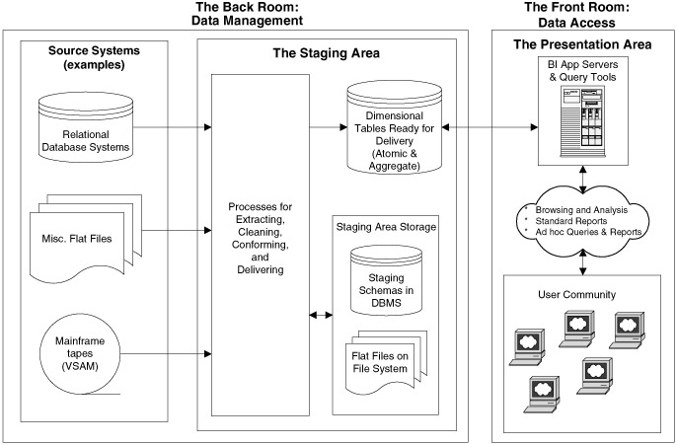
Data Warehouse Architecture

Slide 9
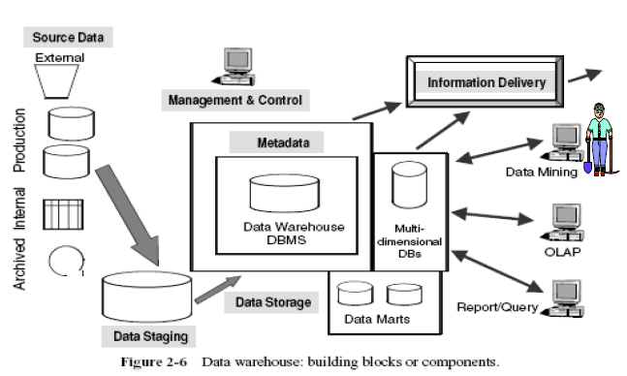
Data Warehouse COMPONENTS

Slide 10
Data Warehouse COMPONENTS
Source Data Component
Production Data.
Internal Data.
Archived Data.
External Data.
Data Staging Component
Data Extraction
Data Transformation.
Data Loading.

Slide 11
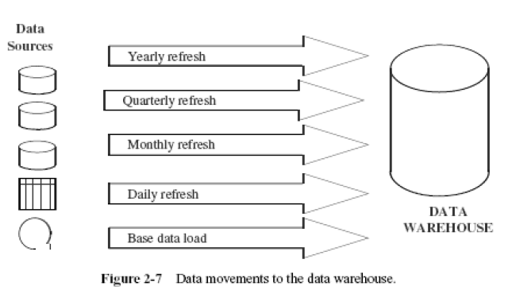
Data Loading

Slide 12
Data Storage Component
Many of the data warehouses also employ multidimensional database management systems. Data extracted from the data
warehouse storage is aggregated in many ways and the summary data is kept in the multidimensional databases (MDDBs). Such multidimensional database systems are usually proprietary products.

Slide 13
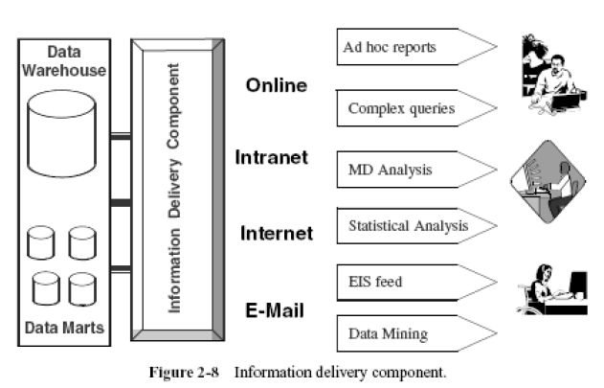
Information Delivery Component

Slide 14
Metadata Component
Metadata in a data warehouse is similar to a data dictionary, but much more than a data dictionary.
Types of Metadata
Operational Metadata
Extraction and Transformation Metadata
End-User Metadata
More Details in Chapter 9.

Slide 15
Why Meta Data: Special Significance
First, it acts as the glue that connects all parts of the data warehouse.
Next, it provides information about the contents and structures to the developers.
Finally, it opens the door to the end-users and makes the contents recognizable in their own terms.

Slide 16
 The architecture
Operational
data source1
Query Manage
Warehouse Manager
Reporting, query,
application development,
and EIS (executive information system) tools
DBMS
Meta-data
High
summarized data
Operational
data source 2
Lightly
summarized
data
Load Manager
Operational
data source n
Detailed data
OLAP(online analytical processing) tools
Operational
data store (ods)
Operational data store (ODS)
Data mining
Archive/backup
data
End-user
access tools
Typical architecture of a data warehouse

Slide 17
 The main components
Operational data sources → for the DW is supplied from mainframe operational data held in first generation hierarchical and network databases, departmental data held in proprietary file systems, private data held on workstaions and private serves and external systems such as the Internet, commercially available DB, or DB assoicated with and organization’s suppliers or customers
Operational datastore (ODS) → is a repository of current and integrated operational data used for analysis. It is often structured and supplied with data in the same way as the data warehouse, but may in fact simply act as a staging area for data to be moved into the warehouse

Slide 18
 The main components
load manager → also called the frontend component, it performance all the operations associated with the extraction and loading of data into the warehouse. These operations include simple transformations of the data to prepare the data for entry into the warehouse
warehouse manager → performs all the operations associated with the management of the data in the warehouse. The operations performed by this component include analysis of data to ensure consistency, transformation and merging of source data, creation of indexes and views, generation of denormalizations and aggregations, and archiving and backing-up data

Slide 19
 The main components
query manager → also called backend component, it performs all the operations associated with the management of user queries. The operations performed by this component include directing queries to the appropriate tables and scheduling the execution of queries
detailed, lightly and lightly summarized data, archive/backup data
meta-data
end-user access tools → can be categorized into five main groups: data reporting and query tools, application development tools, executive information system (EIS) tools, online analytical processing (OLAP) tools, and data mining tools

Slide 20
 Data flows
Inflow- The processes associated with the extraction, cleansing, and loading of the data from the source systems into the data warehouse.
upflow- The process associated with adding value to the data in the warehouse through summarizing, packaging, packaging, and distribution of the data
downflow- The processes associated with archiving and backing-up of data in the warehouse
outflow- The process associated with making the data availabe to the end-users
Meta-flow- The processes associated with the management of the meta-data

Slide 21
Operational
data source1
Warehouse Manager
Reporting, query,application
development, and EIS (executive information system) tools
Warehouse Manager
DBMS
Meta-data
Meta-flow
High
summarized data
Inflow
Lightly
summarized
data
Outflow
Load
Manager
OLAP (online analytical processing) tools
Upflow
Query Manage
Operational
data source n
Detailed data
Operational
data store (ods)
Data mining tools
Downflow
Archive/backup
data
End-user
access tools
Information flows of a data warehouse

Slide 22
 Tools and Technologies
The critical steps in the construction of a data warehouse:
a. Extraction
b. Cleansing
c. Transformation
after the critical steps, loading the results into target system can be carried out either by separate products, or by a single, categories:
code generators
database data replication tools
dynamic transformation engines

Slide 23
Data Cleaning
Why?
Data warehouse contains data that is analyzed for business decisions
More data and multiple sources could mean more errors in the data and harder to trace such errors
Results in incorrect analysis
Detecting data anomalies and rectifying them early has huge payoffs
Long Term Solution
Change business practices and data entry tools
Repository for meta-data

Slide 24
Soundex Algorithms
Misspelled terms
For example NAMES
Phonetic algorithms – can find similar sounding names
Based on the six phonetic classifications of human speech sounds

Slide 25
Data Warehouse Design
OLTP Systems are Data Capture Systems
“DATA IN” systems
DW are “DATA OUT” systems
OLTP
DW

Slide 26
Analyzing the DATA
Active Analysis – User Queries
User-guided data analysis
Show me how X varies with Y
OLAP
Automated Analysis – Data Mining
What’s in there?
Set the computer FREE on your data
Supervised Learning (classification)
Unsupervised Learning (clustering)

Slide 27
OLAP Queries
How much of product P1 was sold in 2009 state wise?
Top 5 selling products in 2010
Total Sales in Q1 of FY 2008-09?
Color wise sales figure of cars from 2008 to 2010
Model wise sales of cars for the month of Jan from 2006 to 2010

Slide 28
Data Mining Investigations
Which type of customers are more likely to spend most with us in the coming year?
What additional products are most likely to be sold to customers who buy sportswear?
In which area should we open a new store in the next year?
What are the characteristics of customers most likely to default on their loans before the year is out?

Slide 29
Continuum of Analysis
Specialized Algorithms
SQL
OLAP
Data Mining
OLTP
Primitive & Canned Analysis
Complex Ad-hoc Analysis
Automated Analysis

Slide 30
Net Resources
Online Resources
The Data Warehousing Institute
www.tdwi.org
Data Warehousing on www
www.datawarehousing.org
www.datawarehousing.com
Online Magazines & Periodicals
www.intelligententerprise.com
www.dmreview.com
www.cio.com
www.daniel-lemire.com/OLAP/index.html

